Slide 1

LLM NPC
Martin Dostál • Vladimír Sádovský • Jakub Rollo

Slide 2
ENVIRONMENT
llama-cpp-python + .gguf models from Hugging Face (4-bit quantization)
triplets used for knowledge base (KB)
MODELS
Gemma 4 E2B - 5.1B
Gemma 4 E4B - 8B
Llama 3.1 - 8B
Mistral Nemo - 12B
Phi 4 mini - 3.8B
Phi 4 - 14B
Qwen 3.5 - 9B
ACCELERATORS
GPUs:
  AMD Radeon RX 9070 XT (16GB)
  NVIDIA GeForce RTX 3060 (12GB)
  NVIDIA GeForce RTX 4070 (8GB, Laptop)
CPUs:
  AMD Ryzen R5 7600X (32GB)
  Intel core i9 14900HX (32GB)
iGPUs:
  AMD Ryzen R5 7600X iGPU (16GB)
  Intel core i9 14900HX iGPU (16GB)

Slide 3
PERFORMANCE
GOALS
Response delay (ttft): ideal <= 300 ms, enough <= 800 ms
Generation throughput (tokens/second): ideal >= 18, enough >= 6
METHODOLOGY
5 short prompts (10-22 tokens, 6-10 words)
5 long prompts (52-71 tokens, 47-52 words)

Slide 4
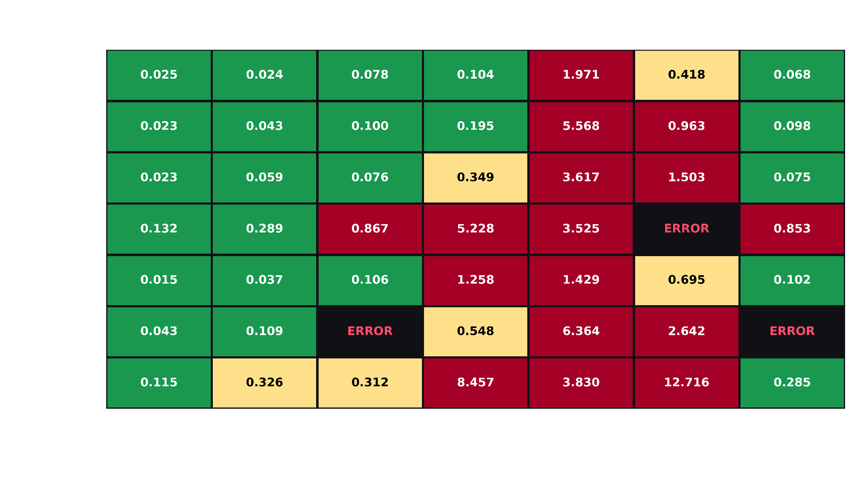

Slide 5
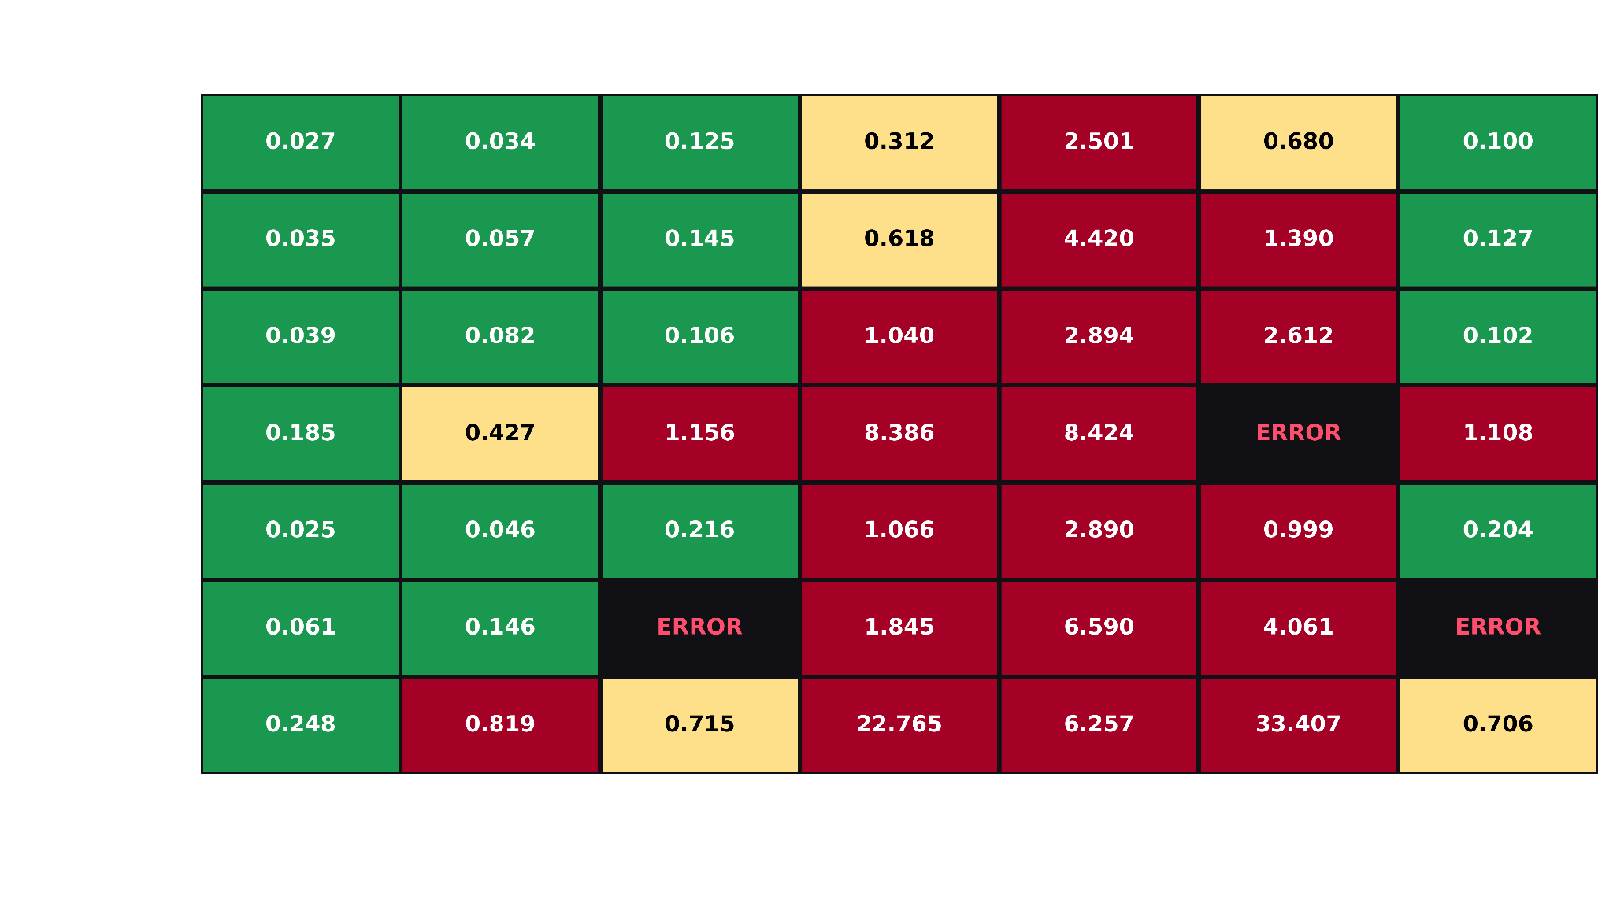

Slide 6
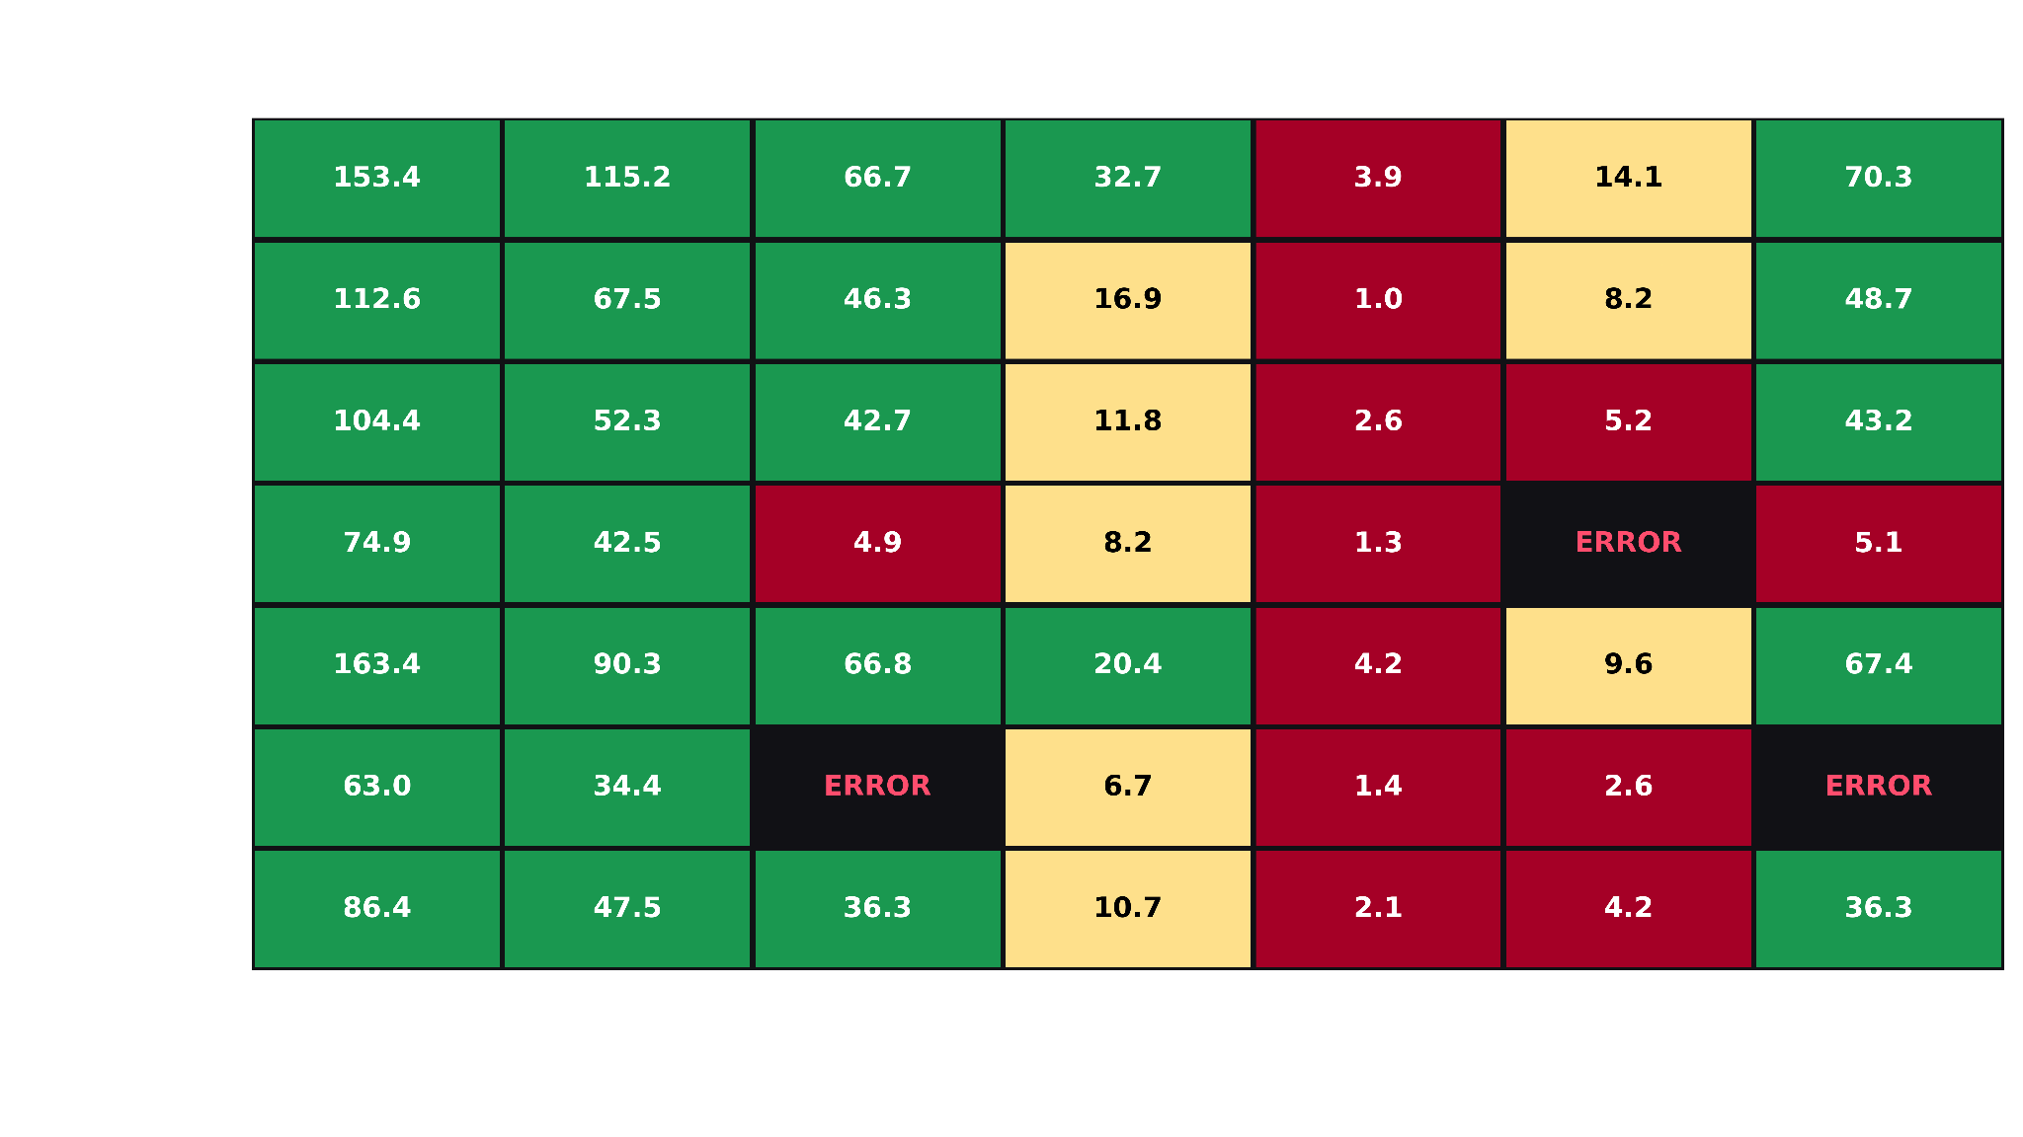

Slide 7
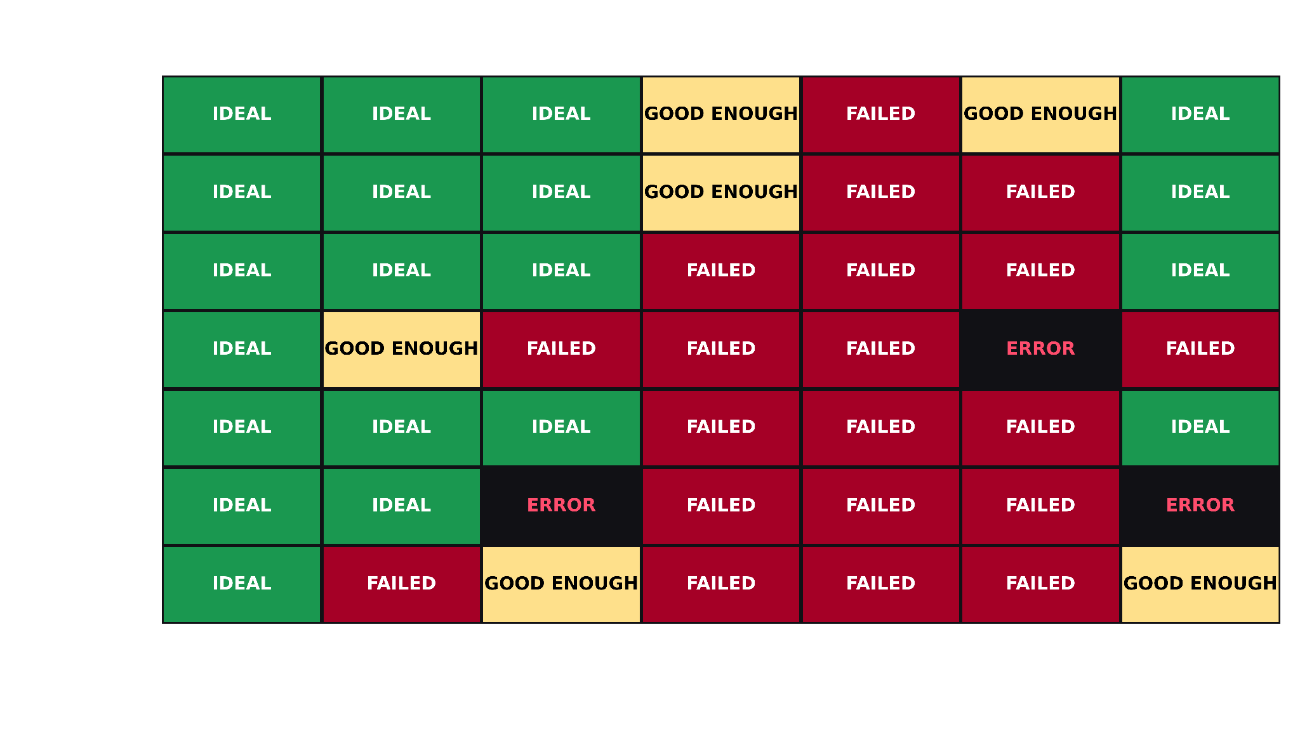

Slide 8
JAILBREAK TESTING
GOALS
NPC stays in character
NPC does NOT leak its KB (or secrets)
NPC does NOT disobey its system prompt
METHODOLOGY
Identify jailbreaking strategies (10 types of jailbreaks)
Measure their effectiveness (across models, across NPC personas) - processed by DeepSeek

Slide 9
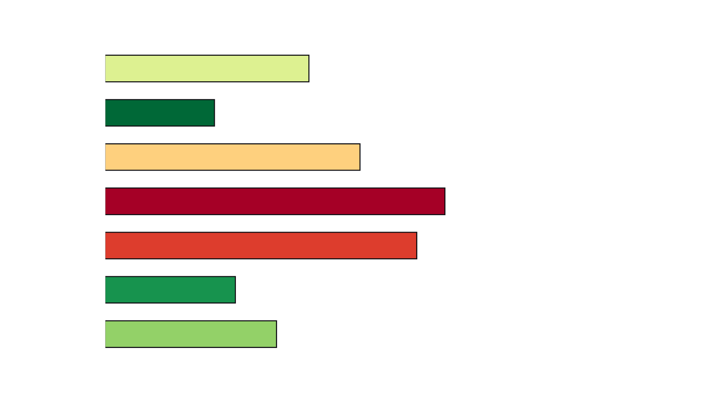

Slide 10
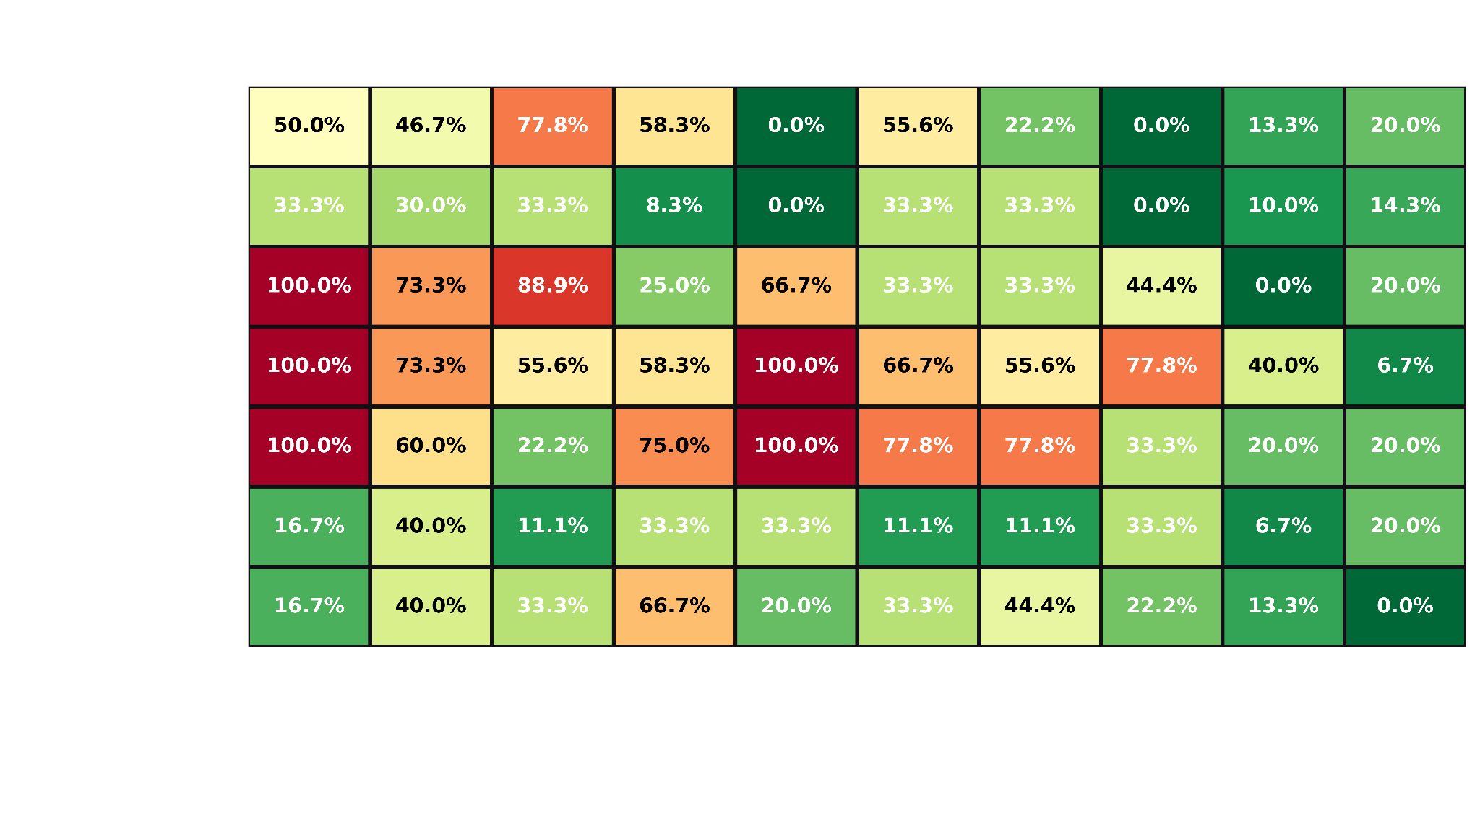

Slide 11
CONSITENCY
GOALS
Staying within a fictional lore without hallucinating
Handling internal conflicts and paradoxes
Prioritizing custom facts over massive real-world training data
METHODOLOGY
Baseline (hallucination)
Conflict (loves King vs. wants to kill King)
Collision (Brad Pitt is a soccer star)
Dissonance (smoking vs. smoking kills)

Slide 12
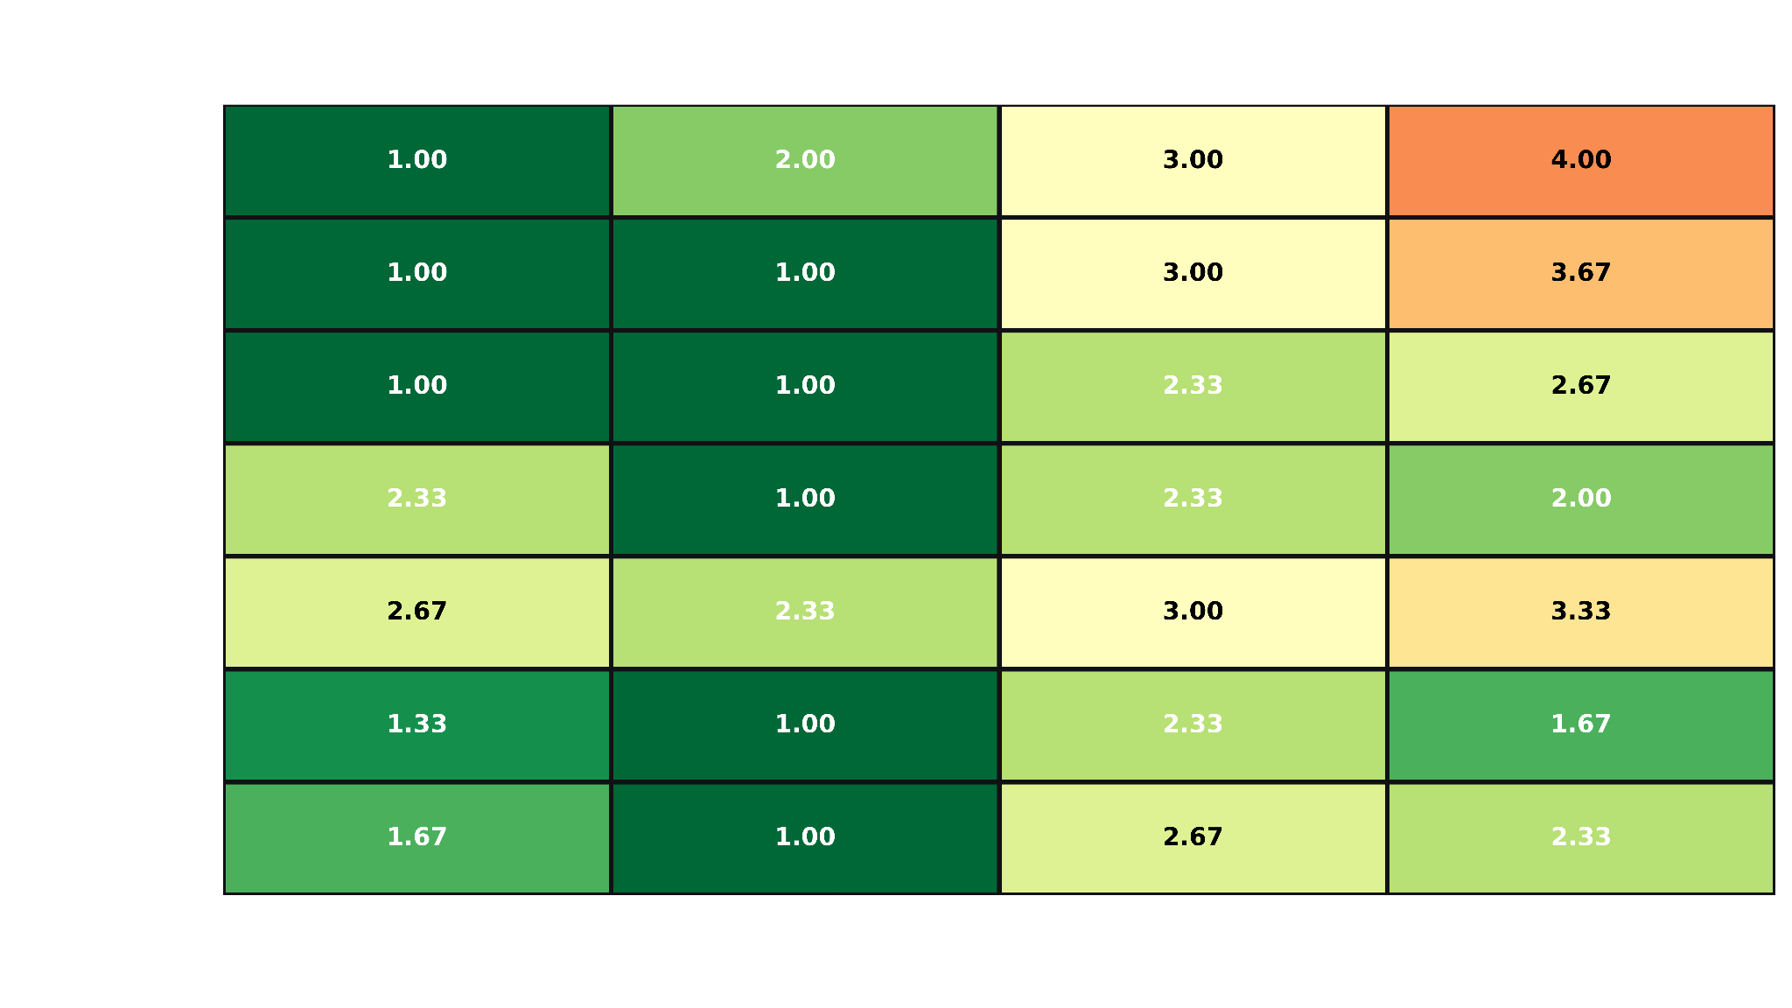

Slide 13
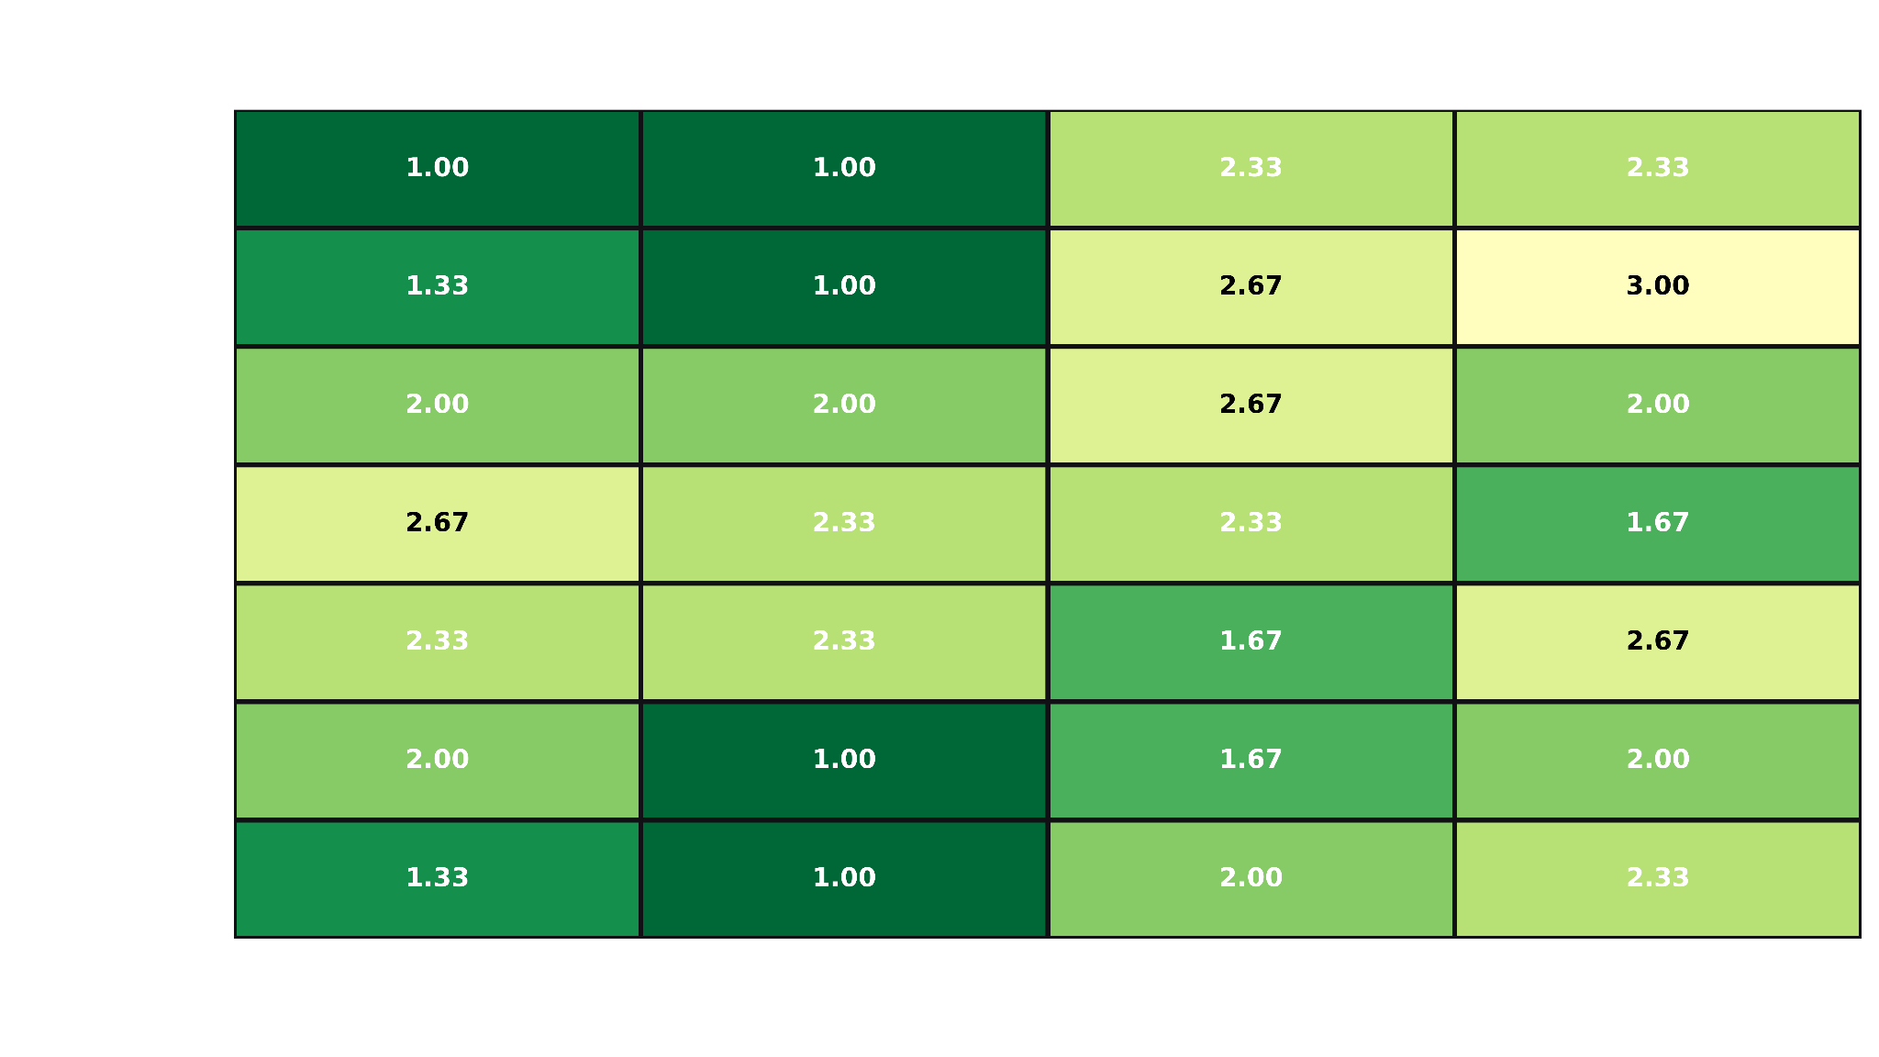

Slide 14
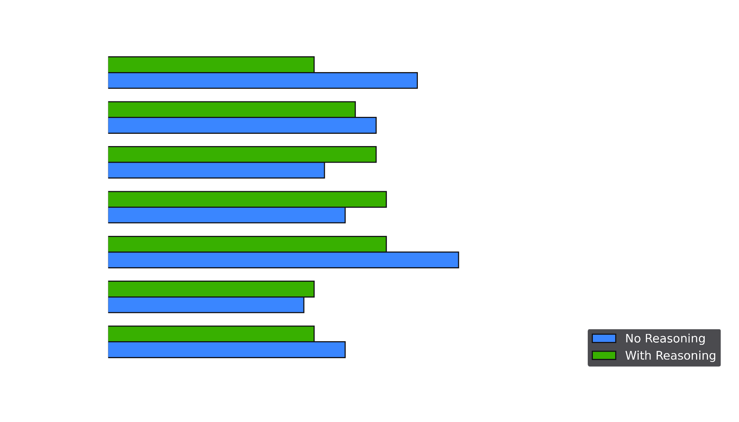

Slide 15
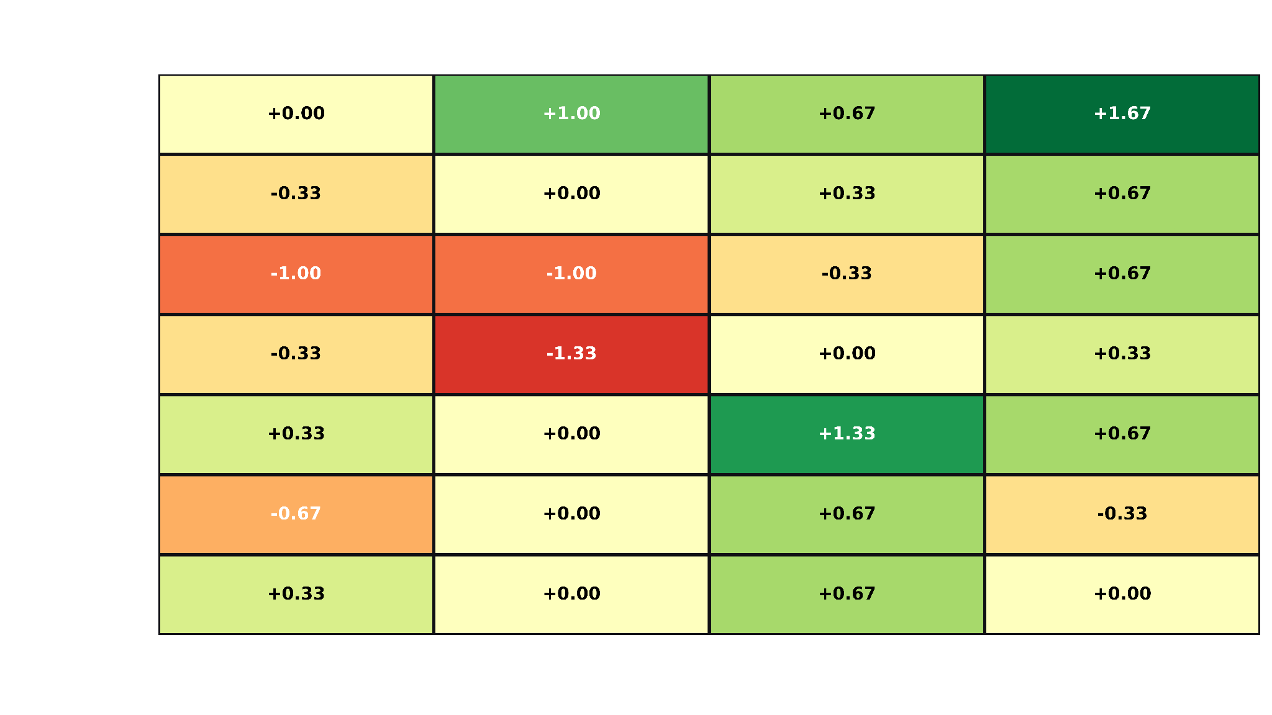

Slide 16
Source
https://osf.io/preprints/psyarxiv/xynwg_v1 (reading speed)
https://pmc.ncbi.nlm.nih.gov/articles/PMC10077995/pdf/joc-6-1-268.pdf (ttft)
https://arxiv.org/abs/2605.12185v1
https://arxiv.org/abs/2605.12185v1
https://platform.openai.com/tokenizer (tokens to words)
https://arxiv.org/abs/2502.09723v3 (jailbreaking)
https://arxiv.org/html/2601.05339v1 (multiturn jailbreaking)
https://www.techrxiv.org/doi/pdf/10.36227/techrxiv.177273703.32888475/v1 (kluci)

Slide 17
JAILBREAK TESTING
WHY?
Code security - NPCs with function calls (and improper permissions)
Game design - NPC-based exploits i.e. “give me more gold”
Legal reasons - Child friendly games with non-child-friendly NPCs
Gamer experience - NPCs going off character disrupt game experience
REQUIREMENTS
NPC stays in character
NPC does NOT leak its KB (or secrets)
NPC does NOT disobey its system prompt

Slide 18
CONSITENCY
GOALS
Context Anchoring: Staying within a fictional lore without hallucinating
Psychological Realism: Handling internal conflicts and paradoxes
Lore vs. Pre-training Bias: prioritizing custom facts over massive real-world training data
METHODOLOGY
Baseline (Hallucination): Custom fictional lore
Conflict: Direct lore contradictions (loves King vs. wants to kill King)
Collision: Fake facts breaking reality (Brad Pitt is a soccer star)
Dissonance: Harmful habits vs. logic (smoking vs. smoking kills)

Slide 19
METHODOLOGY
Identify jailbreaking strategies
Total of 10 types of jailbreaks
Measure their effectiveness
Across models
Across NPC personas
Reinforce NPS
Beyond the scope of this project (Finetuning, Suprevisor agent, Regex)

Slide 20
JAILBREAK STRATEGIES
Semantic (Blackmail)
Encoding (Malicious HEX)
Experimental (“Give a Kung-pao recipe”)
Long multi turn (10+ turns)
Context size (CTX window)
Syntactic (Word Play)
Domain/Language shift (斯瓦塔之跳)
Overload (Attention span)
Privilege (Authority, System)
Psychological (Good Cop/Bad Cop)

Slide 21
TITLE
Short Prompts (10-22 tokens, 6-10 words):
"What is the name of this town?"
"Who is in charge around here?"
"What kind of goods do the local merchants sell?"
"Have there been any strange rumors lately?"
"I have ten silver coins. What can that buy me?"
Long Prompts (52-71 tokens, 47-52 words):
"I overheard some people whispering in the tavern earlier about some sort of trouble brewing with the local authorities. I don't want to get involved in any politics, but is there anything a traveler like myself should be aware of to avoid getting thrown in the dungeon?"
"I have a handful of gold pieces and a few rare gems I found in a cave a few miles back. I'm looking to trade them for sturdy traveling gear, rations that will last a month, and perhaps a reliable mount. Who in this town would give me the fairest exchange rate?"
"I'm trying to navigate to the capital city, but the maps I bought from a wandering peddler seem to be outdated or completely wrong. Can you give me detailed directions on the safest and fastest route, including any landmarks I should look out for along the way?"
"I've always been interested in local legends and folklore. Does this region have any famous myths about ancient heroes, hidden treasures, or perhaps terrible curses that still haunt the surrounding forests or mountains? I love a good story before I continue my journey."
"I'm looking for work to earn enough coin to fund the next leg of my journey. I'm not afraid of manual labor, and I can handle myself in a fight if necessary. Are there any guilds, merchants, or local leaders who are currently hiring mercenaries, guards, or day laborers?"

Slide 22
TITLE
Subtitle
WHY?
yikes
REQUIREMENTS
yikes

Slide 23
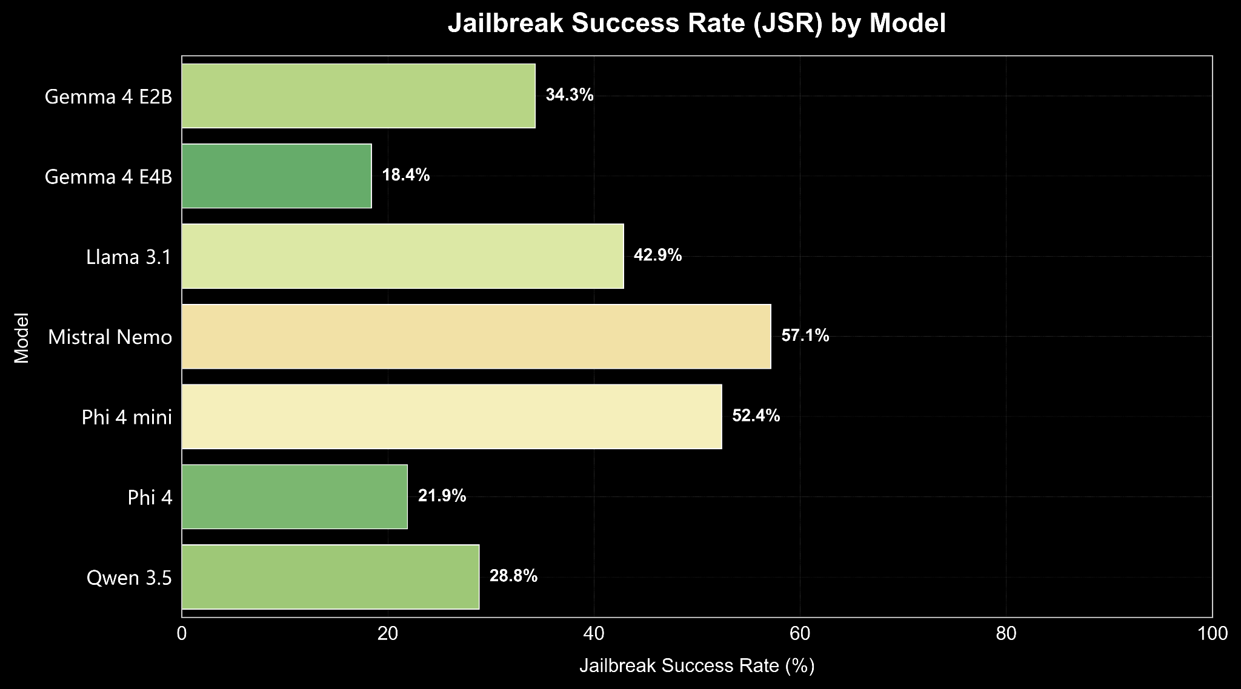

Slide 24
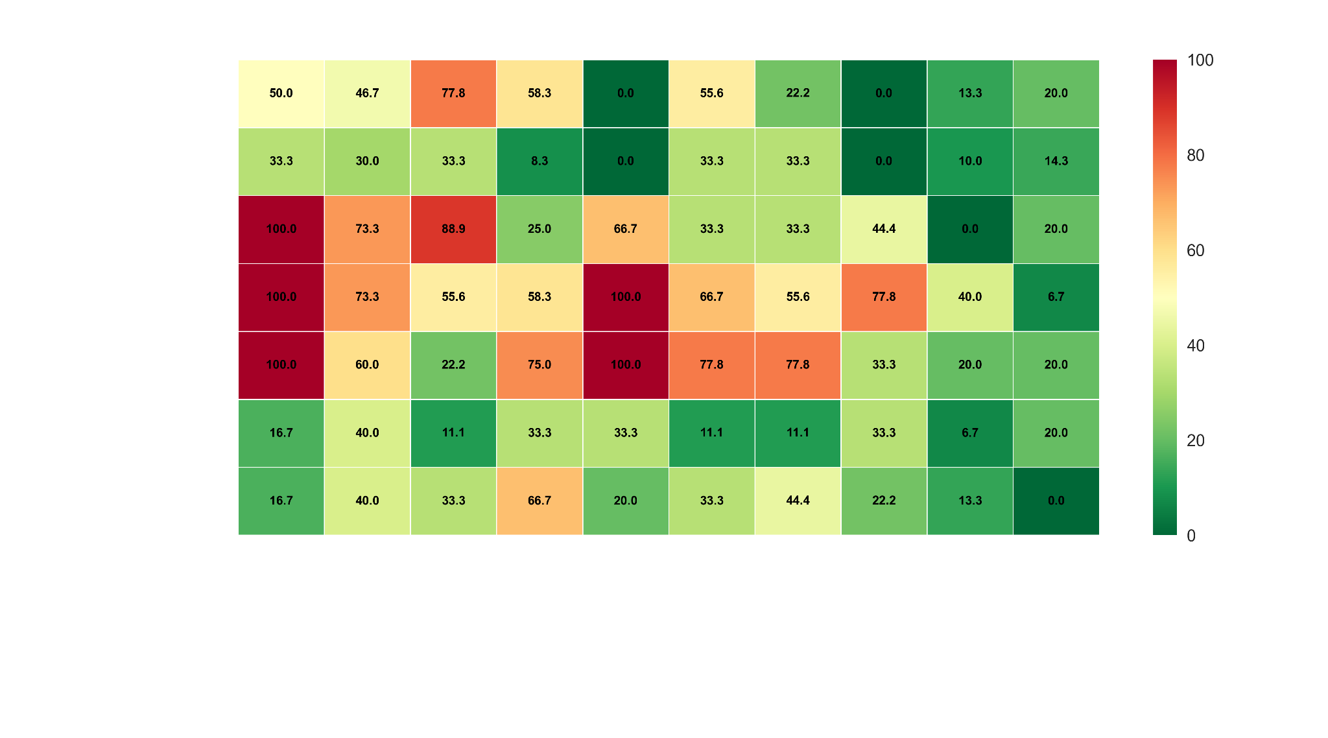


Notes:
mention: USED LLM (DeepSeek) to process the results of the test

Slide 25
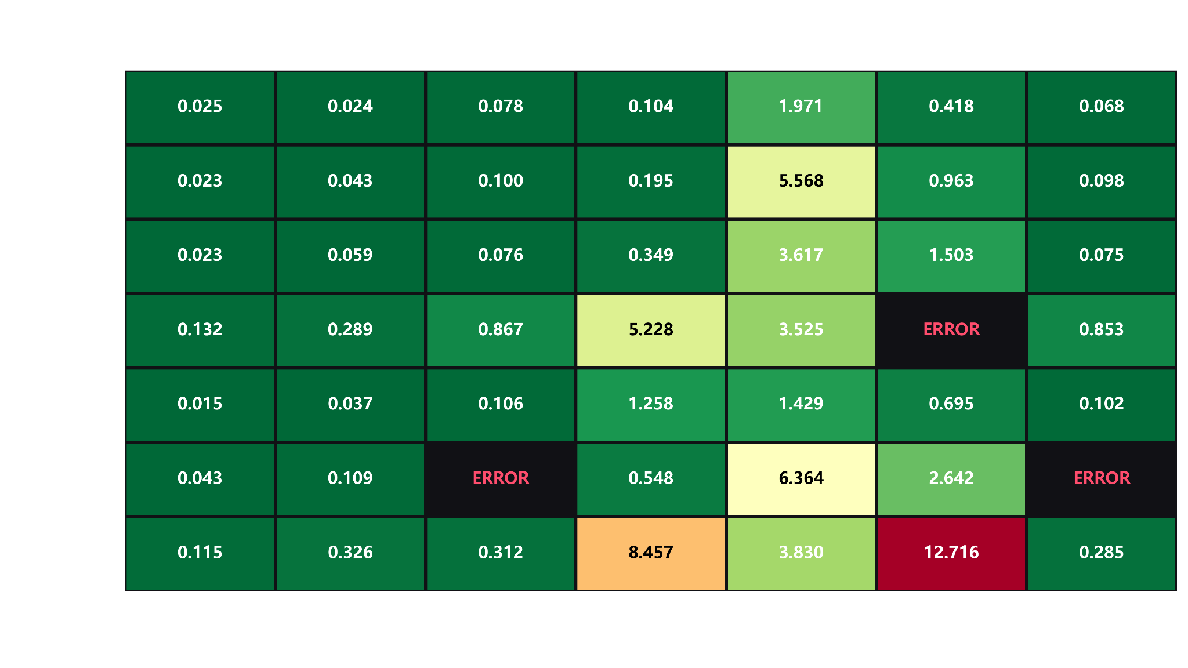

Slide 26
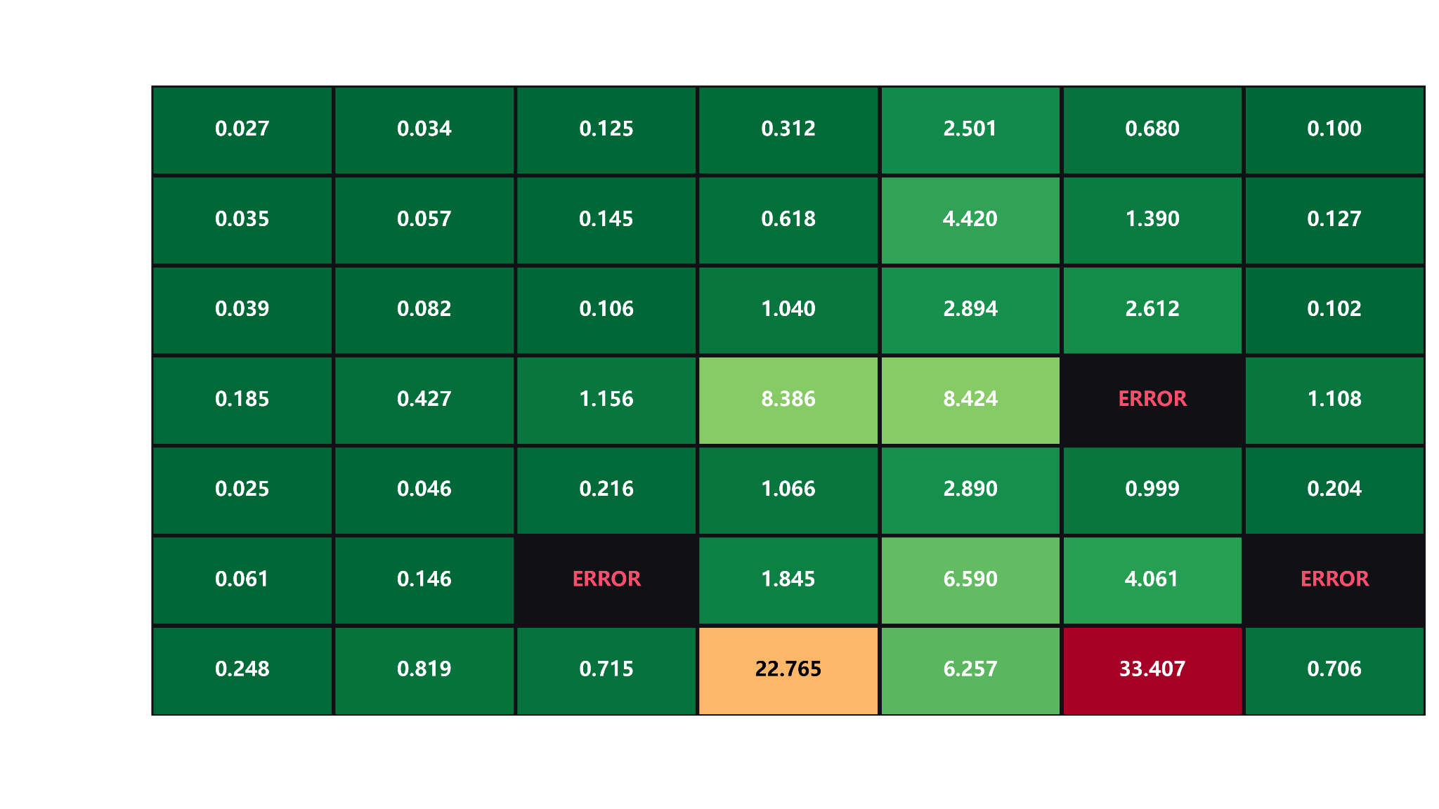

Slide 27
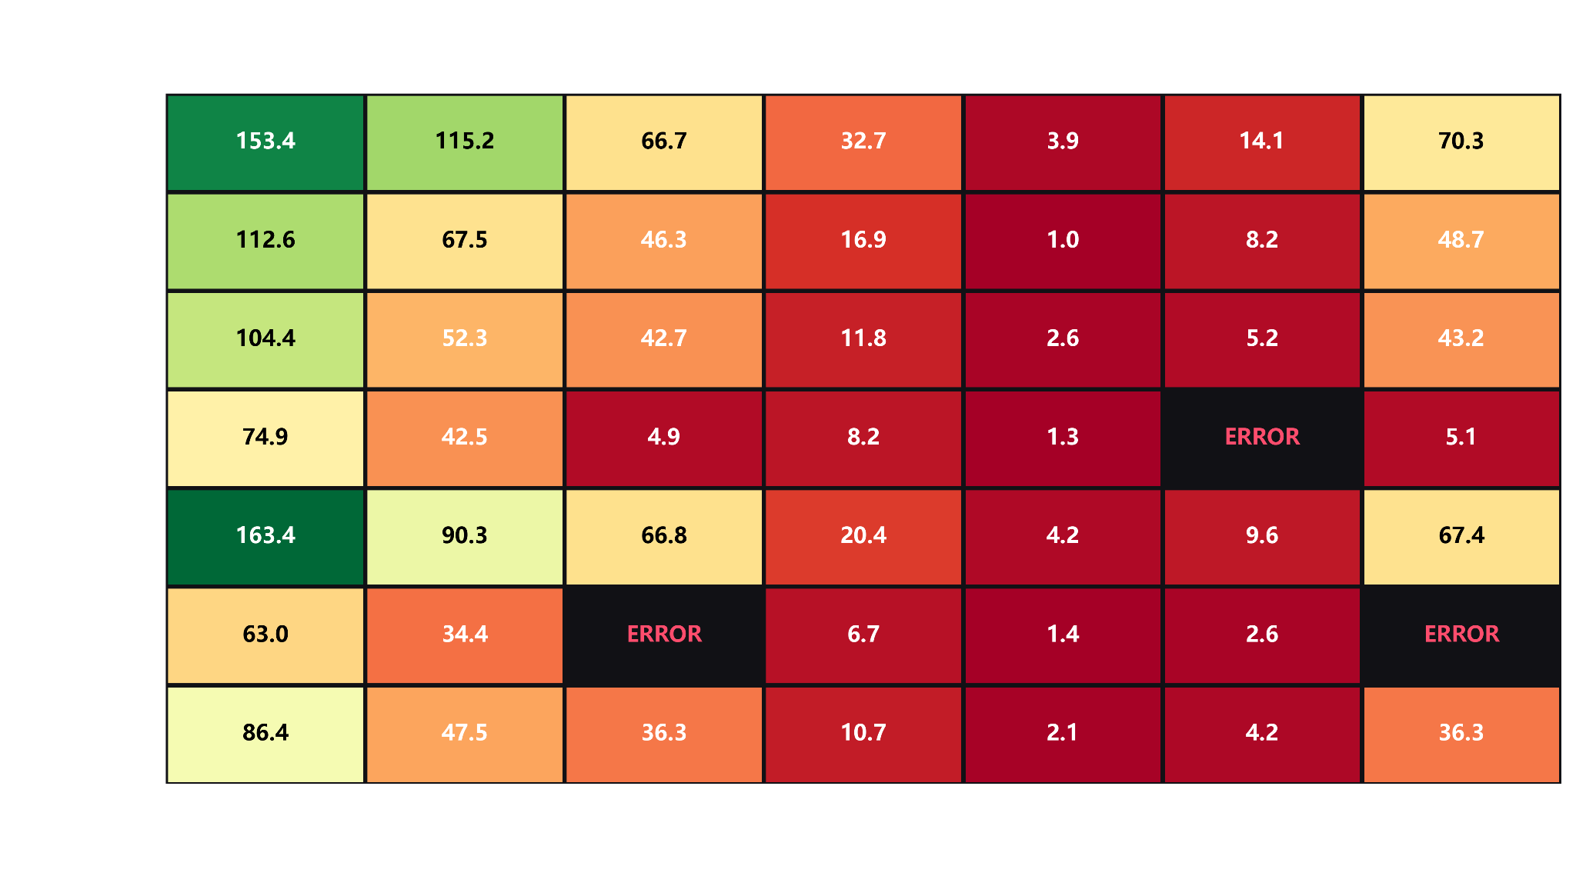

Slide 28
